Slide 1
Norway’s Outer Continental Shelf: Strategic Options for an Evolving Global Market and Geopolitical Landscape
Presented to Top Executives Conference
Norwegian Offshore Industry Authority
30 October 2025
Robert J. Johnston, Ph.D.
Robert.Johnston2@ucalgary.ca

Slide 2
Overview
Geopolitical context for Norwegian oil and gas sector
Key supply side changes- OPEC+ and US shale
Demand-side changes- China + chemicals
LNG – Asia plus AI

Slide 3
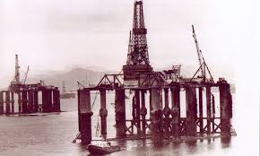
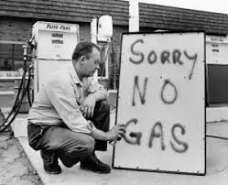
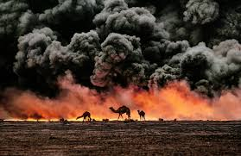
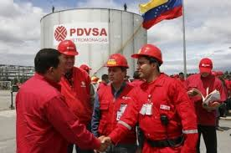
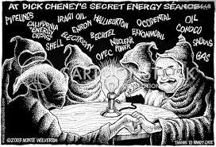
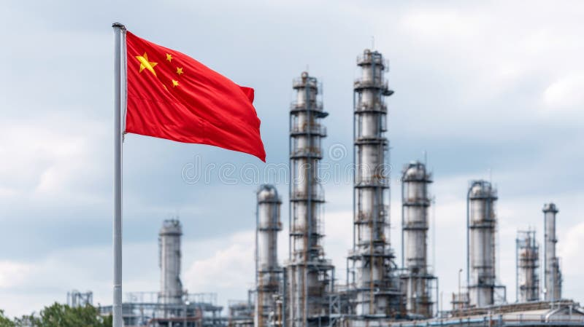
Norway’s offshore origins: the age of energy insecurity, before the shale boom
Energy insecurity
North American import dependence
Peak oil
Nationalization
Oil transit chokepoints
Producer-consumer dialogue

Slide 4
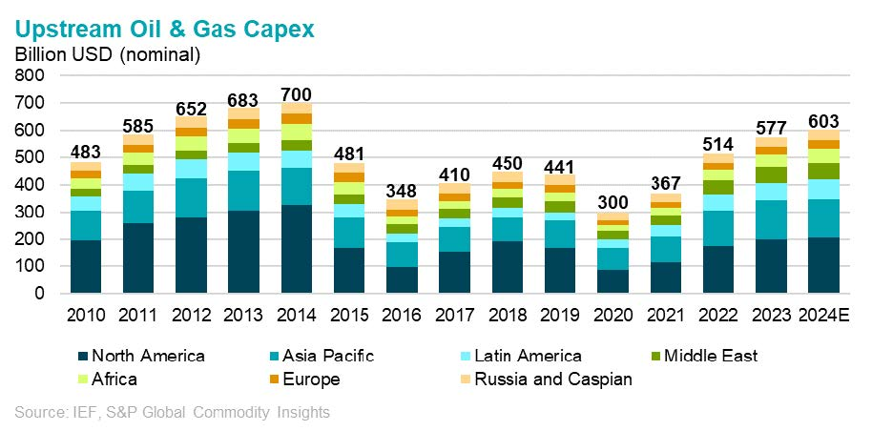
Global supply/demand factors- spare capacity, EM growth, electrification- drive upstream investment
How do these global trends interact with domestic policy?
Global determines the size of the upstream pie; domestic factors shape the size of the slice….
Norwegian policy will influence competitiveness

Slide 5
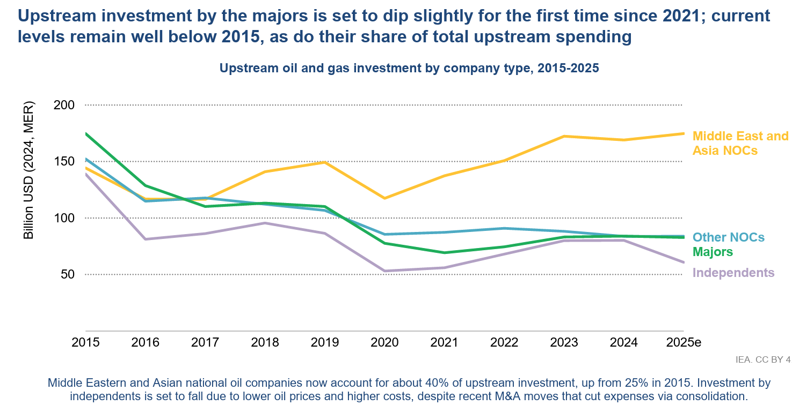
OPEC+ “Core” + Chinese NOCs
Outspending Non-Core OPEC and Majors/Independents

Slide 6
Current Norwegian OCS Context: Global uncertainties around the direction and timing of the energy transition and geopolitics
Inflation
Supply chain disruption
Stranded assets
Affordability & income inequality
War in Ukraine & Middle East
Industrial policy & deglobalization
Electrification & decarbonization
Climate crisis

Slide 7
OPEC+: Saudi remains a swing producer to balance US/Russia/China relationships
 | 1985-86 | 1997-98 | 2014-15 | 2020 | 2024-25
Cause | OPEC over-production; non-OPEC growth in Alaska/North Sea; post-oil shock efficiency & fuel-switching | Asia financial crisis; Venezuela-Saudi-Mexico market share battle; Iraq production recovery | Surging US shale supply | Saudi-Russia tensions over burden-sharing/quota allocation; surging US shale supply | Russia-Ukraine war; unwinding OPEC+ COVID-era cuts
Saudi spare capacity | 7mmbpd | 4mmbpd | 2.5mmbpd | 0 (March 2020) | 2.2mmbpd (Sept 2025)
Annual Brent crude price year/year | $27 (1985) to $14 (1986) | $19 (1997) to $12 (1998) | $98 (2014) to $54 (2015) | $64 (2019) to $40 (2020) | $129 (Mar 2022) to $66 (Sept 2025)
US rig count decline to trough | 1,950 (Nov 1985) to 754 (Apr 1987) | 1009 (Nov 1997) to 496 (Apr 1999) | 1,925 (Nov 2014) to 407 (May 2016) | 676 (Feb 2020) to 172 (Aug 2020) | 784 (Dec 2022) to 542 (Sept 2025)
Exit catalyst | Saudi implementation of production cuts in 1987 | “Troika” agreement in March 1998 | OPEC+ agreement reached November 2016 | OPEC++/G20 agreement- April 2020 | ????
EIA, Baker Hughes, BP World Review of Energy Statistics

Slide 8
Another market share war?
How would this time be different than 2015?
 | 2015 | Current
OPEC+ (Saudi/UAE) | Pursued market share | Currently unwinding COVID-era cuts
OPEC+ (Russia) | Pursued market share | Constrained by sanctions and under-investment
US shale | Ramped from 9mmbpd to 13mmbpd | Expected to top out around 14mmpd and decline
Capital markets | NOCs and shale able to access debt markets | Capital providers (OPEC governments, financial markets) prefer dividends to reinvestment
Climate/ESG policy | Ascending | Stalling

Slide 9
Can the US shale still be a swing producer now?
Greater elasticity of supply in North America, especially US
Market-driven vs government-driven
Could that be changing?

Slide 10
US reindustrialization: sticks, carrots, and energy abundance?
Coercive Diplomacy
Tariffs
Carrots
Low taxes
Deregulation
Cheap energy
SWF & Industrial Subsidies
Sticks
Currency devaluation
Trump’s reindustrialization strategy goes well beyond tariffs- the energy advantage is at its core

Slide 11
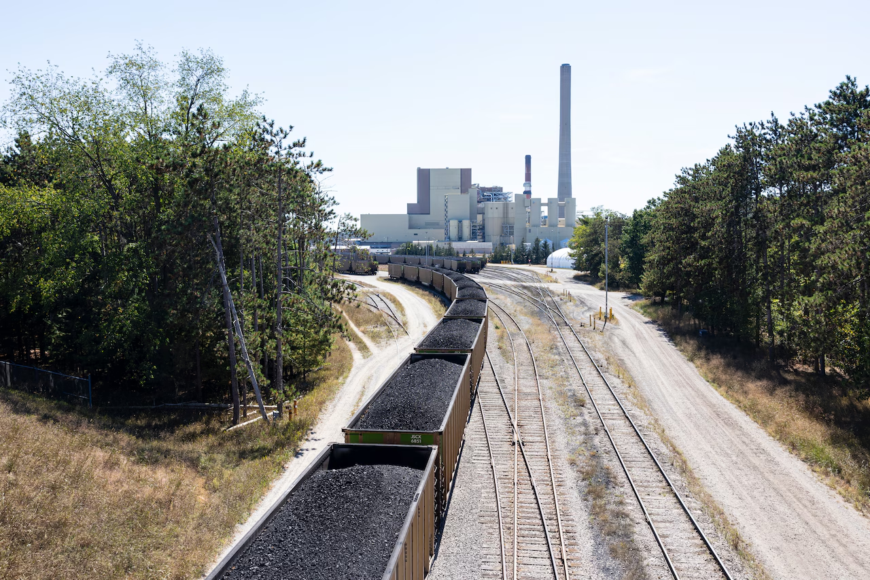
Trump team: cheap energy, not clean energy
Extending the life of coal plants
Fast-tracking permitting- nuclear, new transmission, gas pipelines
Special industrial tariffs
Canceling clean electricity standard type mandates- offshore wind, CCUS
Demand shift from EVs/electrolyzers /heat pumps to AI and manufacturing
JH Campbell coal plant in Michigan – kept open following Trump executive order on 5/30/25 just 24 hours before closure

Slide 12
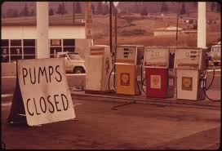
Houston, we have a problem
“The administration is pushing for $40 oil…drilling is going to disappear…”
“The government has effectively aligned with OPEC – using supply tactics to push prices below economic thresholds, kneecapping US producers in the process”
Source: Dallas Fed Survey as reported in Financial Times, 25 September 2025
What are “supply tactics” referenced here?
Contrast with 1970s era price controls & Emergency Petroleum Allocation Act/Cost of Living Council

Slide 13

Geopolitics: economic warfare and sanctions
“We have moved from the age of globalization to the age of economic warfare.”
Rise of sanctions, export controls, and tariffs as primary instrument of state power
Phase I: US multilateral sanctions targeting adversaries- Iran, Russia, Libya
Phase II: US unilateral sanctions and export controls targeting adversaries- China/Huawei, Iran “maximum pressure”
Phase III: US unilateral tariffs targeting allies and trading partners
Phase IV: ?????
Latest Trump push on Russian secondary sanctions targeting China/India- will energy dominance or energy abundance win?

Slide 14
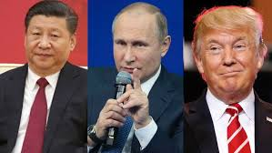
Geopolitics: Great power competition in a post-institutionalist world
Norway and other middle powers stranded in new realignment of global powers
US shifting from status quo power to revisionist power- redefining a global system that was largely built by the US itself
Erosion of global institutions and rules-based order (WTO, WHO, NATO etc) leaves Norway/EU exposed as US withdraws
Disruption of US domestic political institutions creates further risk of instability
Downside risk to trade-sensitive commodities- or new markets and trade routes?

Slide 15
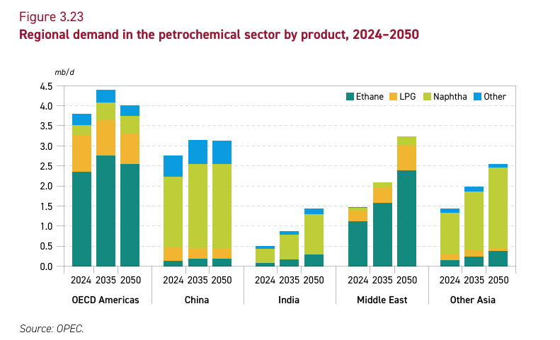




Asia’s petrochemical boom- from OPEC customers to competitors?
Core OPEC/GCC can reconfigure NOC business model to retain relevance; non-core OPEC NOCs cannot

Slide 16
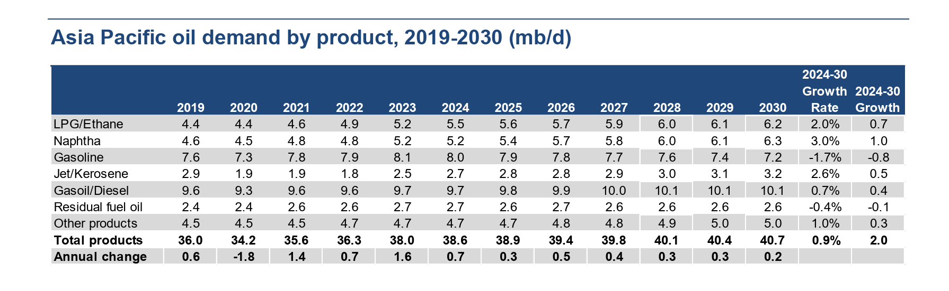


Oil Products Diversification: Asian demand in flux
Source: IEA Oil 2025

Slide 17



Preparing for the era of “crude-to-chemicals”

Slide 18

LNG to Asia equation =
“more expensive coal, less expensive gas”
Electric power: coal-to-LNG, coal to abated gas
Transportation: shipping (bunker to LNG/gas derivatives) and trucking (diesel to CNG)
Industrial: coal-to-chemicals and coking coal/steel
Cooling demand- rising temperatures/bulb points = growth in A/C
AI/data centers
Stronger “pull” from Asia strengthens Norwegian position in Atlantic Basin market- with US cargoes going westward from GOM

Slide 19

LNG market update: key developments
US LNG start-ups and sanctions continue (Plaquemines T2, Corpus Christi T3, Golden Pass)
Qatari mega-wave of LNG coming to market
Trump/EU/Russia “sanctions for gas” dealings
Trump pushback on EU methane regs & CSRD regulations
US trade/geopolitical tensions with India and South Korea
Power of Siberia 2 pipeline MOU- 50bcm
Will glut/lower prices stimulate demand?

Slide 20
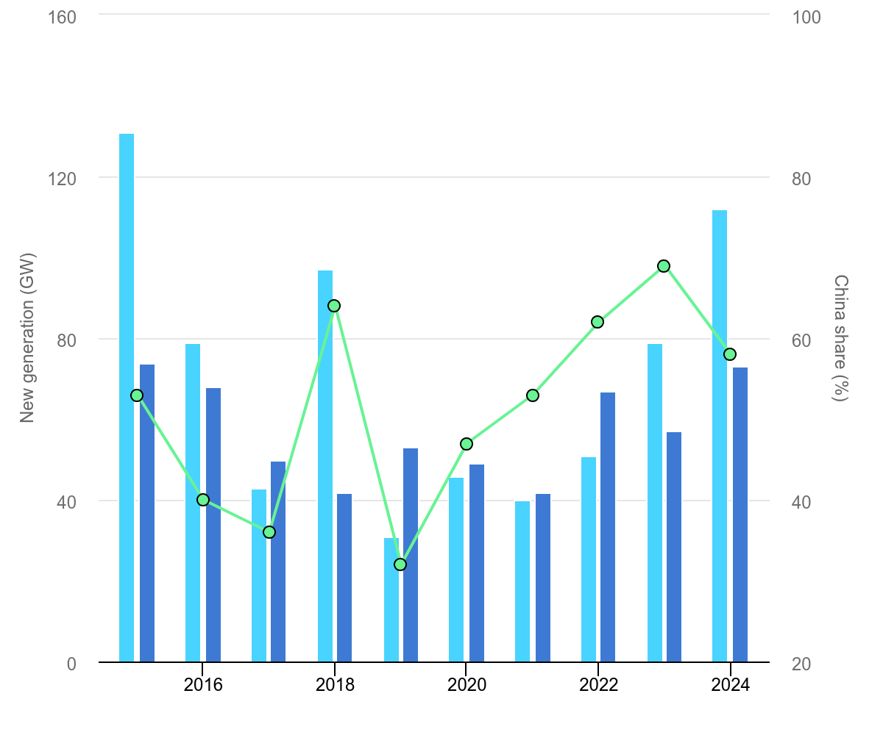
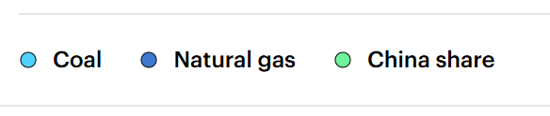
China’s “electro-state” dominating power plant construction
Coal outpacing gas-fired generation- particularly ex-OECD countries
Gas too expensive in many non-OECD markets
IEA (2025), New coal and natural gas-fired generation Final Investment Decisions, 2015-2025, IEA, Paris https://www.iea.org/data-and-statistics/charts/new-coal-and-natural-gas-fired-generation-final-investment-decisions-2015-2025, Licence: CC BY 4.0

Slide 21
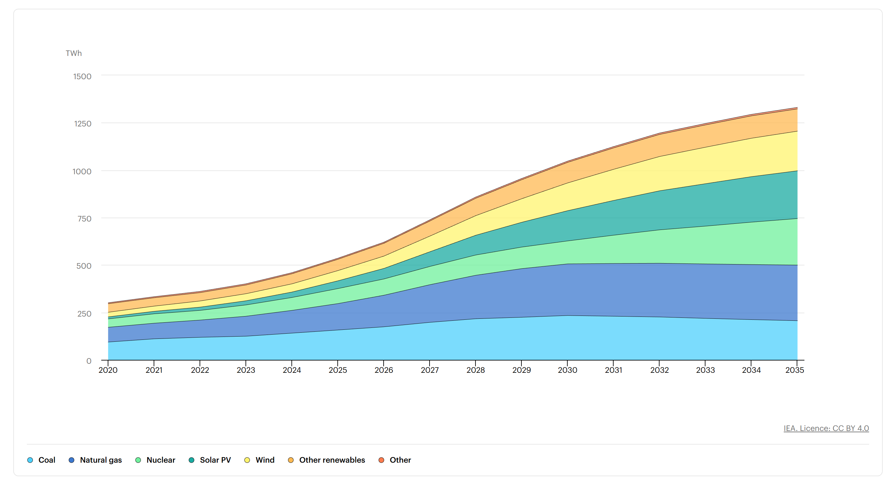
Data center demand growth- peak in coal and gas demand by 2030?
How likely is that to happen?
Sources of global electricity generation for data centres, Base Case, 2020-2035
IEA (2025), Sources of global electricity generation for data centres, Base Case, 2020-2035, IEA, Paris https://www.iea.org/data-and-statistics/charts/sources-of-global-electricity-generation-for-data-centres-base-case-2020-2035, Licence: CC BY 4.0

Slide 22
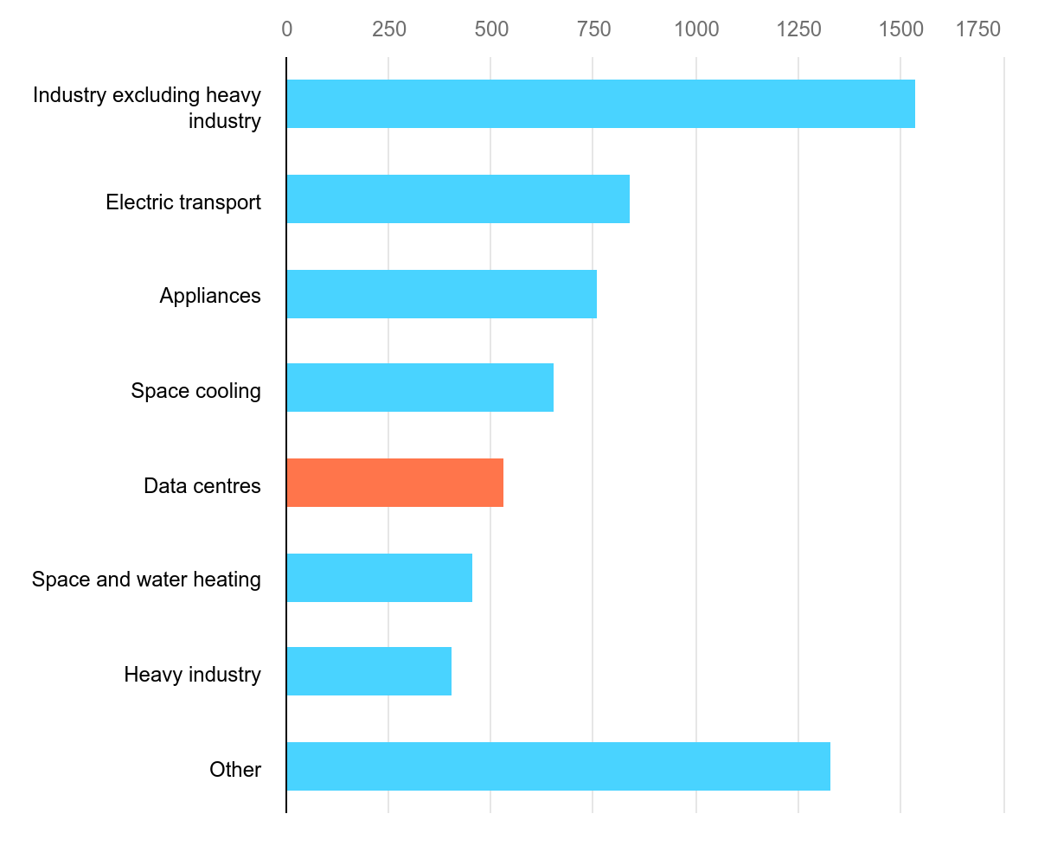



Appliance and cooling demand electricity demand growth exceeds data centers
IEA Global Electricity Demand Growth by Sector 2024-2030 (Twh)
IEA (2025), Increase in electricity demand by sector, Base Case, 2024-2030, IEA, Paris https://www.iea.org/data-and-statistics/charts/increase-in-electricity-demand-by-sector-base-case-2024-2030, Licence: CC BY 4.0

Slide 23

Heat key driver of coal demand in SE Asia: redefining energy security & highlighting energy/public health link
“Electricity demand in Southeast Asia is set to surge at an annual rate of 4%, the report projects, with growing use of air conditioning amid more frequent heatwaves a big driver of increased electricity consumption.”
https://www.iea.org/news/southeast-asias-role-in-the-global-energy-system-is-set-to-grow-strongly-over-next-decade

Slide 24
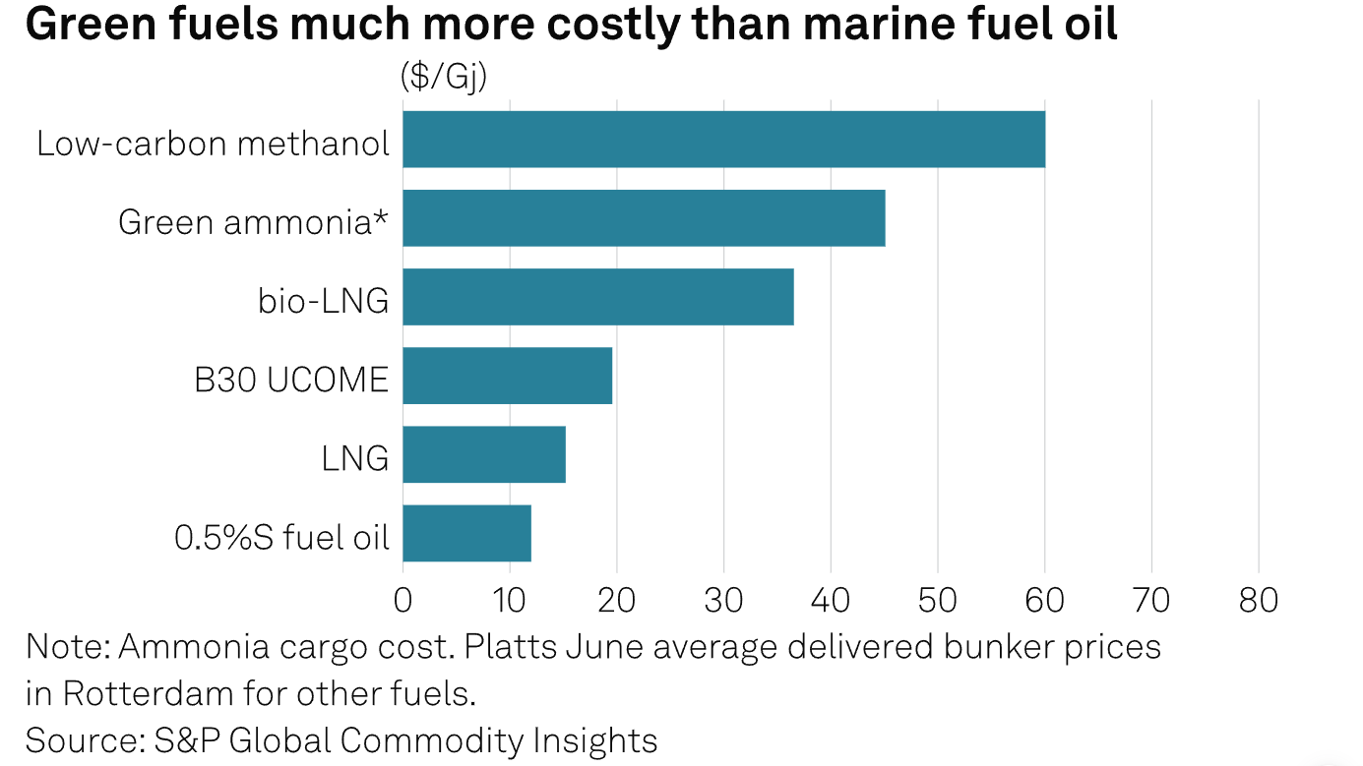
Shipping/maritime markets are opportunity for abated gas
Shipping: grey/green/blue competition – layered on top of LNG/methanol/ammonia competition
Dual-fuel bunker/LNG winning for now
IMO ratification + EU leadership driving decarbonization
Traditional fuel oil/bunker market +/- 5mmbpd globally

Slide 25
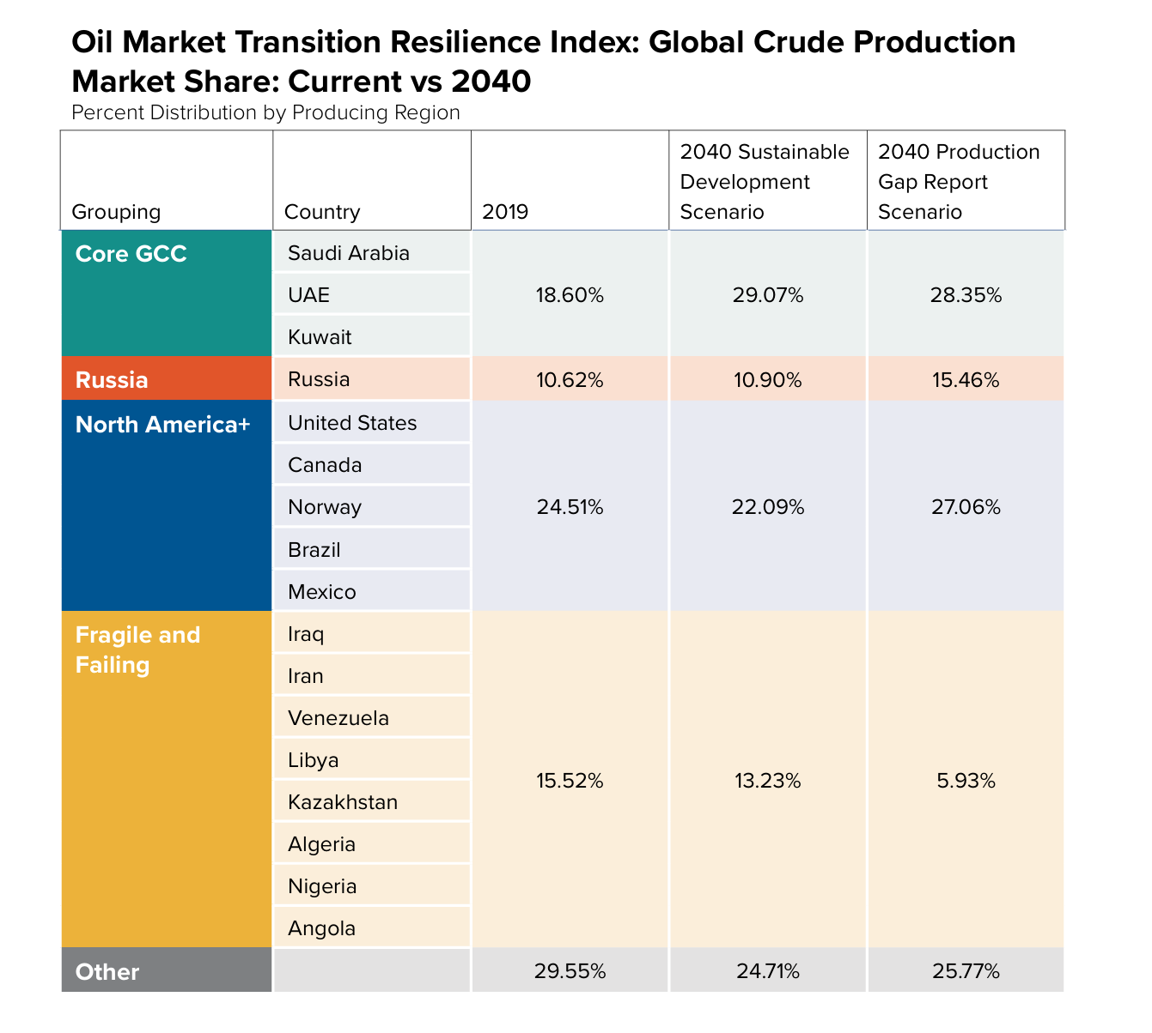
Conclusion- Norway and other advanced producers likely to outlast “Fragile & Failed Petro-States”
The “Fragile & Failed” group of producers have relatively low production costs but are offset by higher country risk and cost of capital.
In practical terms, this means future investment will typically demand a higher rate of return to account for above-ground risk.
In the peak demand scenarios, markets will be more averse to funding such projects
Norway and other innovative producers will be more resilient upstream markets
Source: /https://www.atlanticcouncil.org/wp-content/uploads/2021/06/Final-Shifting_Gears_Geopolitics-of-the-Global-Energy-Transition.pdf

